Slide 1
MODEL IMPROVEMENT STEPS | MODEL LOSS | MODEL ACCURACY
First model | 0.560304523 | 0.72723031
Features Reduced | 0.574125707 | 0.722099125
Activation Function (Tanh) | 0.573746562 | 0.719679296
Increased Hidden layers | 0.573750436 | 0.722332358
Dropout Regularization | 0.576659501 | 0.722449005
Test Size(40%) + Tanh Activation | 0.573746562 | 0.719679296
Automated Model (All Features) | 0.559253216 | 0.731195331
Automated Model (Reduced Features) | 0.572828531 | 0.723265290
Final Optimization (Organization Names Included) | 0.469225376 | 0.778309047

Slide 2
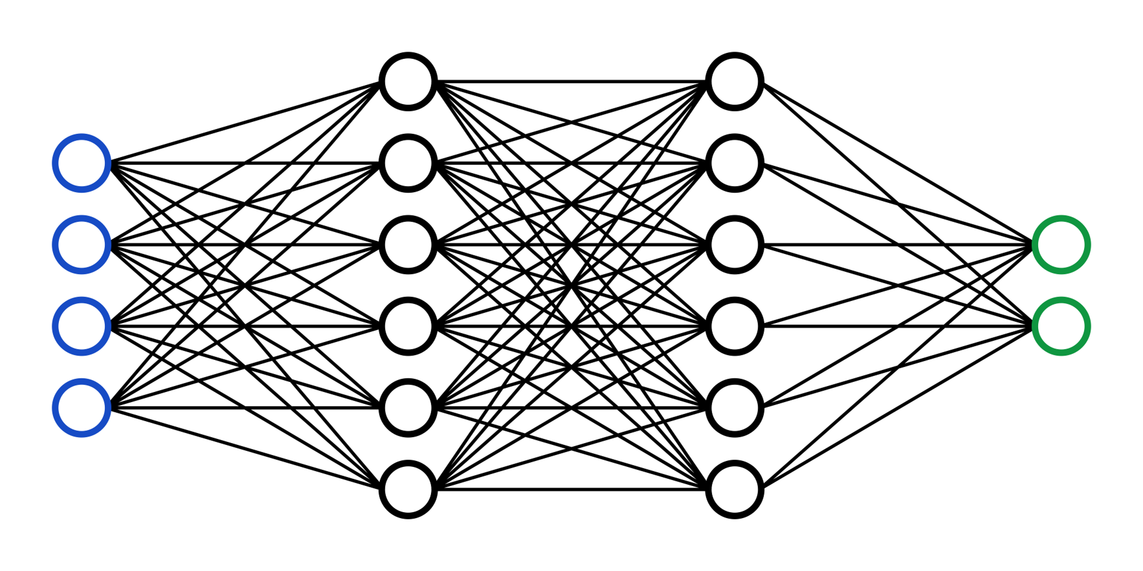
Successful
Input Features
Not Successful

